Slide 1
Bardia Mojra
Adept Technology, Inc.
Interview Presentation
3/7/2016

Slide 2
Overview
Overview
About Me
Quiz
Intelligent Ground Vehicle Competition (IGVC)
UAV-UGV Coalition
CarryBot and GarbageBot
Portable Arsenic Detector
Electric Lawn Mower
Answer
Questions

Slide 3
Quiz
Why?

Slide 4
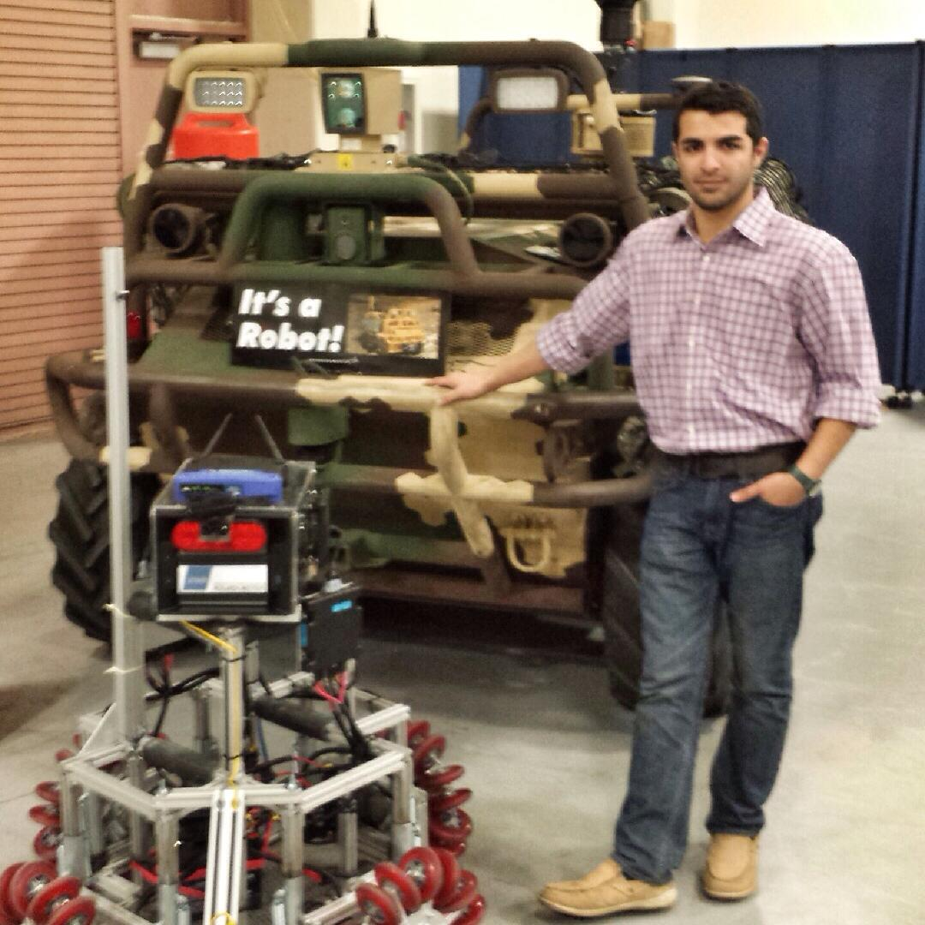
About Me
24 years old
BSEE from University of Texas – Arlington
Focused on Robotic Systems, Embedded Systems, & Control Systems
Built first circuit at 8, first robot at 13
Have a passion for what I do, It makes me happy
Looking for an opportunity that matches my interests and goals

Slide 5
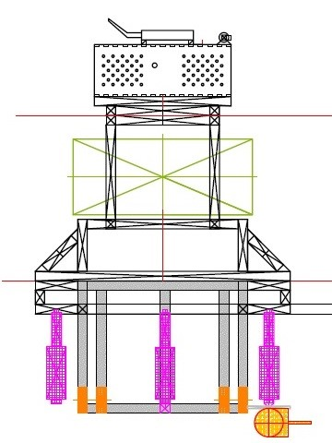
IGVC
Founded the team with 5 other students
Led a multidisciplinary team
Designed and developed the hardware system
2 iterations, Marauder and Yoshimi
Worked closely with software and mechanical teams
$35,000 budget annually

Slide 6
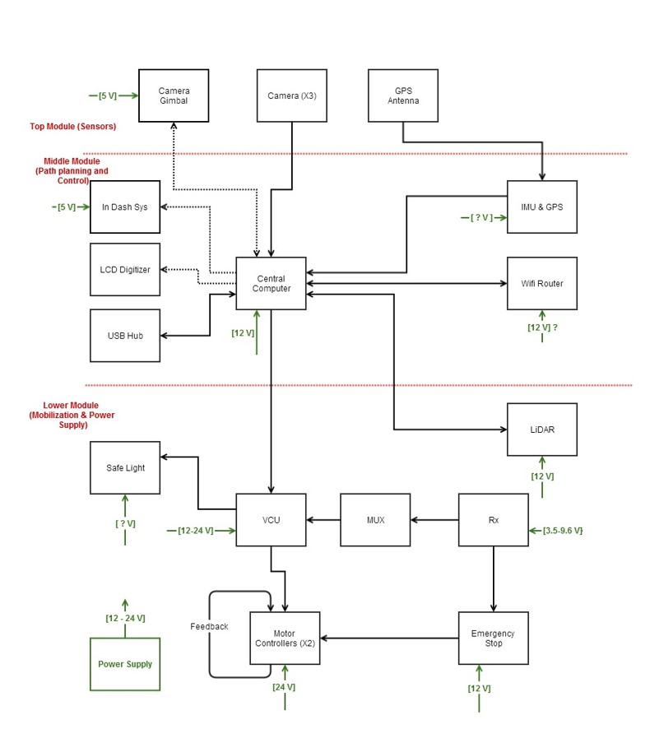
IGVC
Designed and Developed
Power distribution system
Vehicle navigation unit- PCB
LED driver - PCB
E-stop
Magnetic Encoder - PCB
Lockheed Martin – Missiles & Fire Control
Placed 12th (2013) & 15th (2014) in the design competition

Slide 7
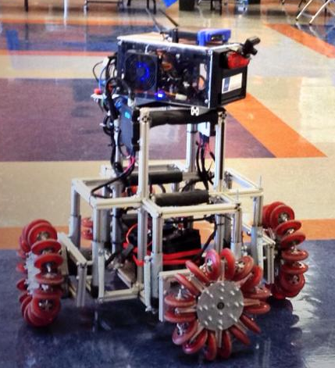
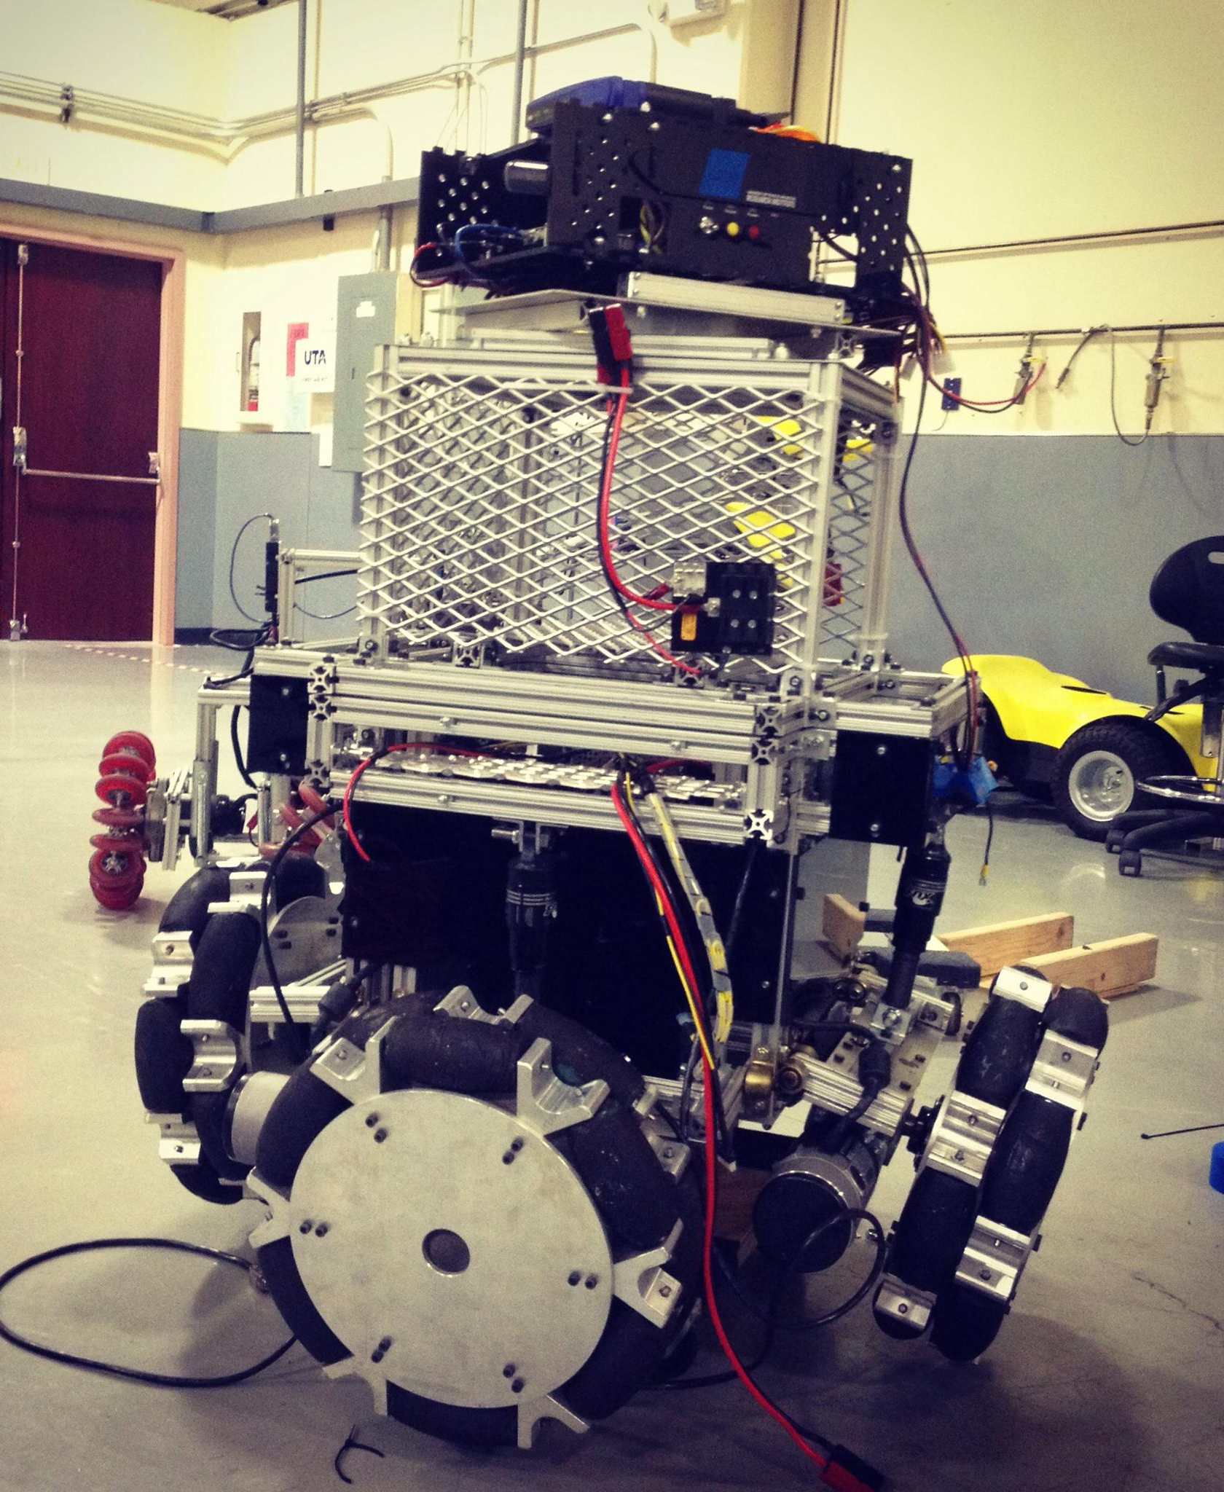
IGVC
Marauder - 2013
Yoshimi - 2014

Slide 8
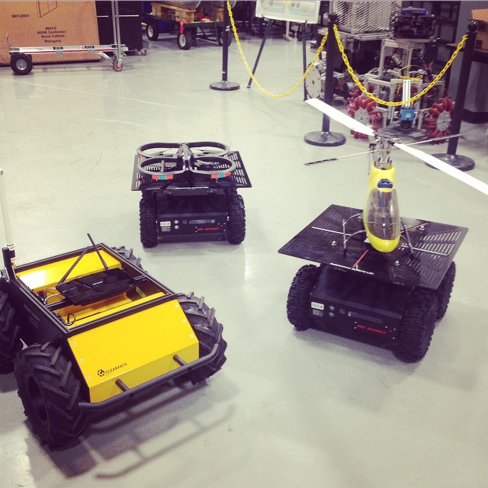
UAV-UGV Coalition
Autonomous Systems Lab.
Dr. Frank Lewis
In charge of hardware and systems integration
US Army Tank Automotive Research, Development & Engineering Center (TARDEC)
1 year

Slide 9
CarryBot Project
Robotics Division, UTA Research Institute
Lead Intern
Overall design and systems integration
Multidisciplinary – undergrad and graduate interns
Assistive robotics application, multi-agent system
Design, schedules, BOM, documentation, prototyping, test procedures
3 robots, 15 iterations
Student Employee Award of Excellence
Confidential
Please contact division chief Mike McNair for more information

Slide 10
Portable Arsenic Detector
Multiscale Manufacturing Technologies & Hybrid Systems, UTA Research Institute
Embedded Software Intern
Focused on embedded systems both hardware and software
Developed the control system
Developed the GUI

Slide 11
Electric Lawn Mower
Embedded hardware and software
Control system
Power distribution
Motor driver
PCB design and fabrication
BOM and purchasing

Slide 12
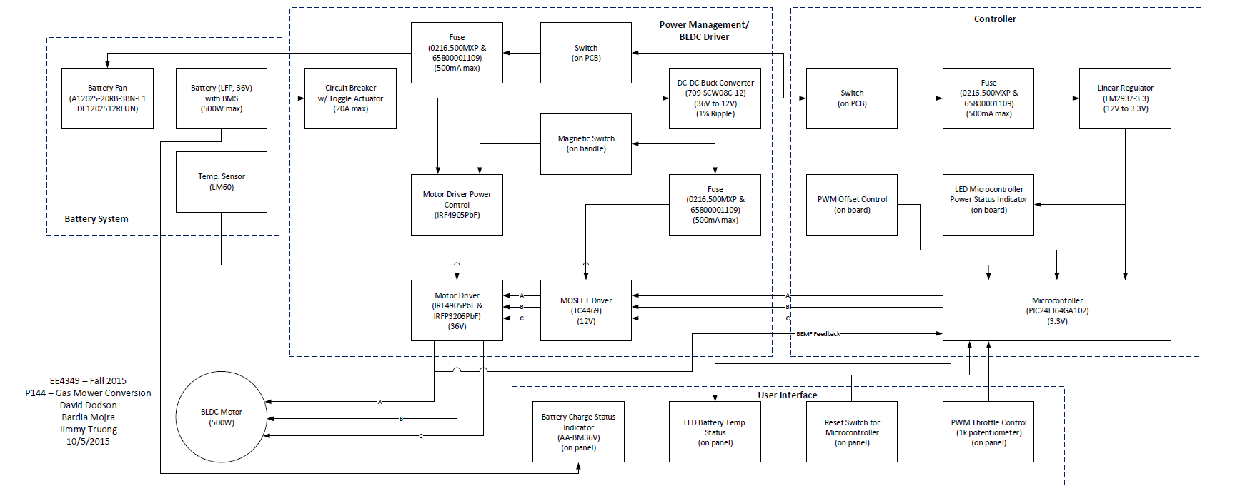
Electric Lawn Mower

Slide 13
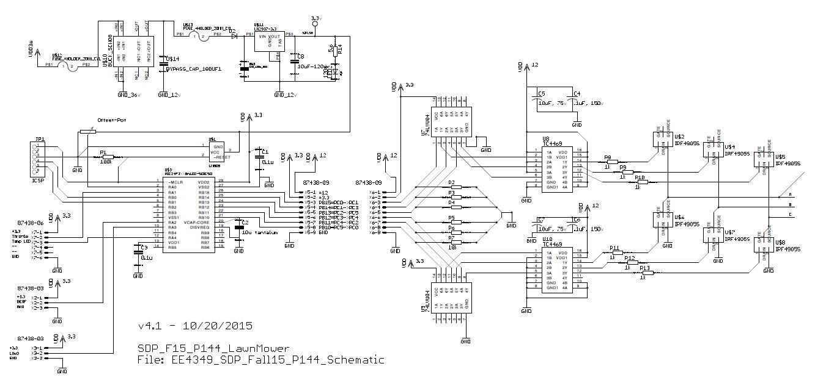
Electric Lawn Mower

Slide 14
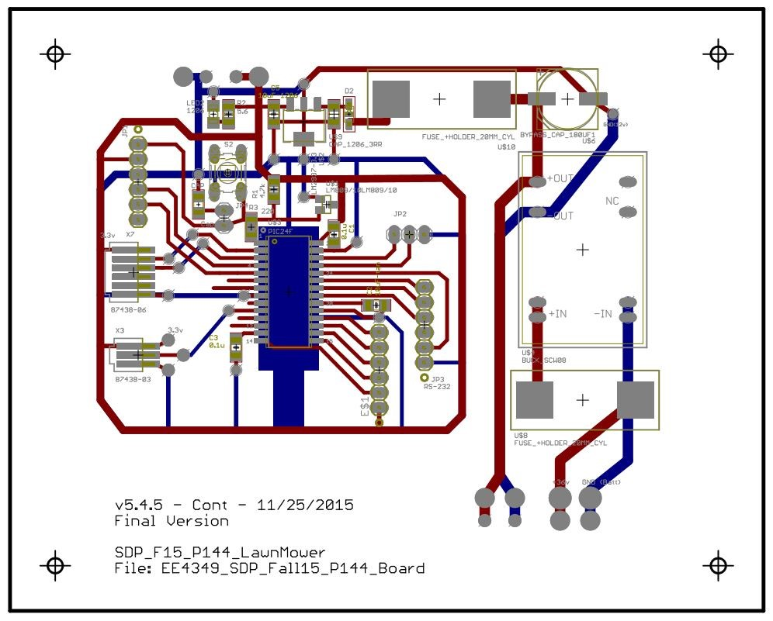
Electric Lawn Mower

Slide 15
Answer
There is a pattern:
Why Henry Ford’s first production car is called model T?
Why didn’t Nikola Tesla move on with his life and start a family?
Why didn’t Albert Einstein stop working even when his health declined?
Because it is important to push forward and make progress. Humans learn collectively and it is our civic duty to be productive and creative.

Slide 16
Questions
Thank you for your attention!

